Slide 1
Joins
Customers table
Orders table
Customer id | Customer name | phno
1 | rahul | 4578346587
2 | sachin | 3465466534
3 | rohit | 3455345455
4 | kohli | 5664564566
Order id | Customer id | order_details
1 | 1 | Pizza , coke
2 | 1 | Burger , french fries
3 | 3 | French fries , pepsi
4 | 4 | Idly , Sambar
5 | 2 | Paneer tikka , diet coke
6 | 1 | Burger , coke

Slide 2
Resultant Table
Find the name of customer who placed order_id 5
order_id | customer_id | customer_name | phno | order_details
1 | 1 | rahul | 4578346587 | Pizza , coke
2 | 1 | rahul | 4578346587 | Burger , french fries
3 | 3 | rohit | 3455345455 | French fries , pepsi
4 | 4 | kohli | 5664564566 | Idly , Sambar
5 | 2 | sachin | 3465466534 | Paneer tikka , diet coke
6 | 1 | rahul | 4578346587 | Burger , coke

Slide 3
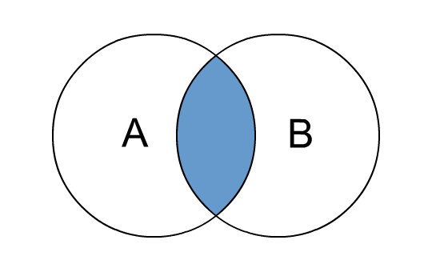
Inner Join
concatenate the records only if the customer_id in both tables match

